Slide 1
Dyslexia Overview
How are our youngest students impacted?
https://bit.ly/2Hrr0TN

Slide 2
Definition - NH RSA 200:58
"Dyslexia'' means a specific learning disability that is:
(a) Neurobiological in origin;
(b) Characterized by difficulties with accurate or fluent word recognition and by poor spelling and decoding abilities that typically result from a deficit in the phonological component of language; and
(c) Often unexpected in relation to other cognitive abilities and the provision of effective classroom instruction, and may include secondary consequences such as reading comprehension problems and reduced reading experience that can impede growth of vocabulary and background knowledge.

Slide 3
Definition - International Dyslexia Association
Dyslexia is a specific learning disability that is neurological in origin. It is characterized by difficulties with accurate and/or fluent word recognition and by poor spelling and decoding abilities. These difficulties typically result from a deficit in the phonological component of language that is often unexpected in relation to other cognitive abilities and the provision of effective classroom instruction. Secondary consequences may include problems in reading comprehension and reduced reading experience that can impede the growth of vocabulary and background knowledge.

Slide 4
What does it look like?
General problems experienced by people with dyslexia include the following:
Learning to speak
Learning letters and their sounds
Organizing written and spoken language
Memorizing number facts
Reading quickly enough to comprehend
Keeping up with and comprehending longer reading assignments
Spelling
Learning a foreign language
Correctly doing math operations
IDA DITC - Handbook

Slide 5
What does it look like?
Some specific signs for elementary aged children may include:
Difficulty with remembering simple sequences such as counting to 20, naming the days of the week, or reciting the alphabet
Difficulty understanding the rhyming of words, such as knowing that fat rhymes with cat
Trouble recognizing words that begin with the same sound (for example, that bird, baby”, and big all start with b)
Pronunciation difficulties
Trouble easily clapping hands to the rhythm of a song
Difficulty with word retrieval (frequently uses words like “stuff” and “that thing” rather than specific words to name objects)
Trouble remembering names of places and people
Difficulty remembering spoken directions IDA DITC - Handbook

Slide 6
Challenge
The best time to identify students at risk for dyslexia is BEFORE print is introduced. Remember, the heart of dyslexia is in the phonological processing component of reading, the sounds. The increased expectations in the lower grades have pushed academics into Kindergarten so many of the assessments we use now in Kindergarten and First Grade are print based and don’t assess the precursor skills that will identify students at risk. Nor are the precursor skills part of the core curriculum anymore.
b d p q a e a e a

Slide 7
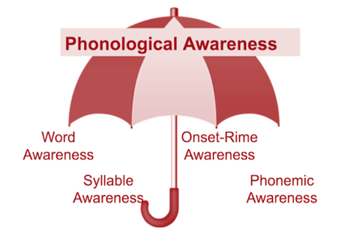
Phonological Awareness
Notes:
Pg 27

Slide 8
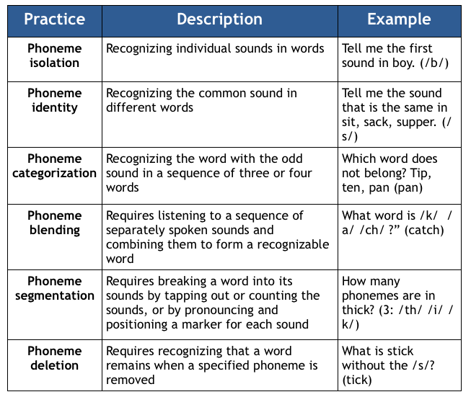
Phonemic Awareness
Notes:
Pg 28

Slide 9
Read - Pair - Share https://bit.ly/2Hrr0TN

Slide 10
Mid Morning Check In
Please complete this quick Google Form before
we come back from the break at 10:15
https://goo.gl/forms/SngEhTv4wr6mM2h63

